Slide 1


Slide 2
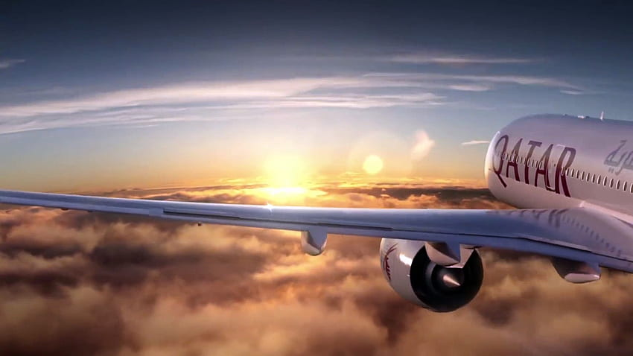

QATAR AIRWAYS
PASSENGER OVERALL EXPERIENCE
REVIEW REPORT

Slide 4
Premium and First-Class Passengers have almost no comments on rating might indicates excellent experience, so company should focus more on business and economy class for providing more value-added services.

Slide 9
1 (WORST) STAR
Top Tagged Review
5 (Average) STAR
Bad Experience (Longer than expected) in Check-ins
Delay or Cancel (Direct & Connecting Flight)
Poor Food Quality
Poor Compensation/ No Compensation
Mismanagement / Miscommunication in Refund
Other Airlines match most of services in lesser price
Food Quality is not up to the mark
Very Slow In-Flight Services
Not properly addressing all the escalations
Premium ticket price but Average overall experience

Slide 18
Company getting most of their business from family leisure and Solo leisure passengers (65%) in terms of having most of the economy class booking, compare to other seat type

Slide 19
KRA (KEY RESULT AREA) of QATAR AVIATION
Business & Economy Class Passenger Experience needs to be Upgraded
Business Travelers/Passengers should be more prioritized in terms addressing and resolving escalations/issues on time
Company Should resolve top tagged Reviews to get better ratings
Asia, Middle East and Central Europe could be the next most targeted customer base
Among top rated Aircraft few (Boing 787, 777, etc.) needs to be monitored in terms of providing better experience
In last 8-10 years both 10 (Excellent) Star & 1 (Worst) Star Rating Deteriorate than expected, hence Management should work on shortfalls
Very less or 0 booking in First Class and Premium Economy Class compare to other class, so company should start promoting more in these segment to get more customers
65% of total customer are coming from Economy class (Family & Solo Leisure) except Qatar (Business Class), so company should prioritized Economy class in terms of resolving most escalated issues at the earliest and promote Business class as well to enhance the business

Slide 20
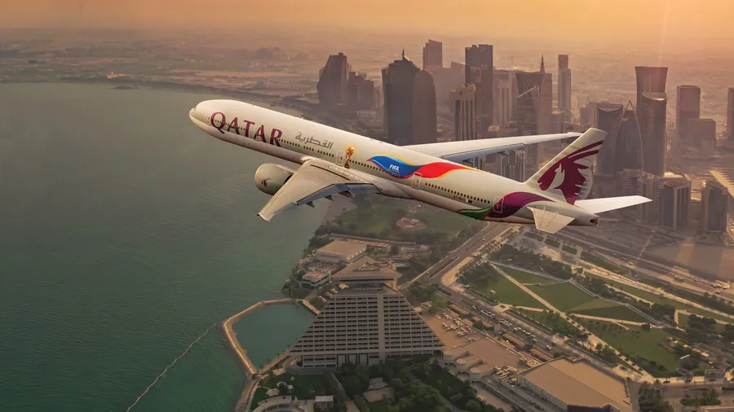
T
H
A
N
K
Y
O
U

